Slide 1
Business Intelligence
Dashboard in Tableau

Slide 2
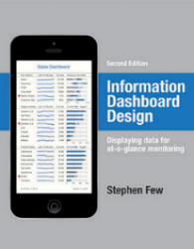

What is a Dashboard?
“A dashboard is a visual display of data used to monitor conditions and/or facilitate understanding”
“A dashboard is a visual display of the most important information needed to achieve one or more objectives; consolidated and arranged on a single screen so the information can be monitored at a glance.”
Big Book of Dashboards (2017)
Stephen Few (2004)
Notes:
Plenty of definitions. Here’s one from Stephen Few. And if you haven’t read his Info Dash Design book – you must!
Right info to the right audience in the right medium so they can digest the information in the shortest time possible.

Slide 3
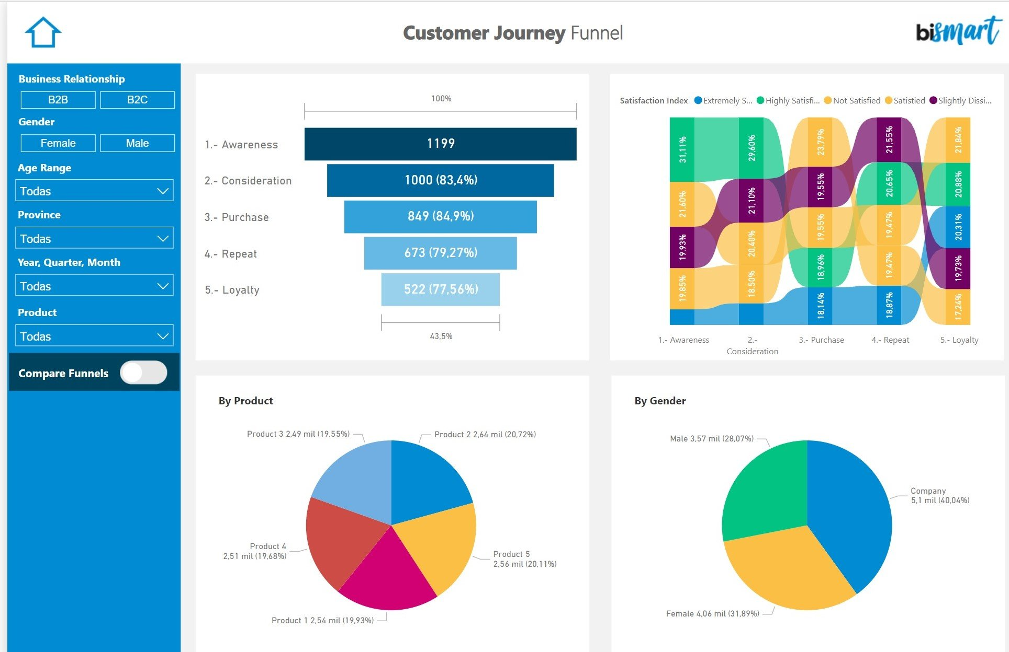
What Makes a Good Dashboard?
Answers a set of questions
Follows a flow and invites interactivity
Primarily in the form of summaries and exceptions
Specific to and customized for the dashboard’s audience and objectives
Makes strategic use of color
Notes:
When it comes to visual best practices, there aren’t any hard and fast rules, such as “do this and never do that.” It isn’t a black and white process. There are, however, guidelines that make sense most of the time. Many of these derive from studies done on how we as humans process things like color, shape, and size. When you really understand the concepts driving these guidelines, only then should you break them.

Slide 4

The User Interface - UI
User interfaces should be designed to match the skills, experience and expectations.
System users often judge a system by its interface rather than its functionality.
A poorly designed interface can cause a user to make catastrophic errors.
Poor user interface design is the reason why so many software systems are never used.

Slide 5
Human Factors in Interface Design
Limited short-term memory
People can instantaneously remember about 7 items of information. If you present more than this, they are more liable to make mistakes.
People make mistakes
When people make mistakes and systems go wrong, inappropriate alarms and messages can increase stress and hence the likelihood of more mistakes.
People have different interaction preferences
Some like pictures, some like text.

Slide 6
UI Design Principles
User familiarity
The interface should be based on user-oriented terms
Consistency
The system should display an appropriate level of consistency
Minimal surprise
If a command operates in a known way, the user should be able to predict the operation of comparable commands

Slide 7
UI Design Principles
User guidance
Some user guidance such as help systems, on-line manuals, etc. should be supplied
User diversity
Interaction facilities for different types of user should be supported. For example, some users have seeing difficulties and so larger text should be available

Slide 8
Design Issues in UIs
Two problems must be addressed in interactive systems design
How should information from the user be provided to the computer system?
How should information from the computer system be presented to the user?
User interaction and information presentation may be integrated through a coherent framework.

Slide 9

Information Presentation
Information presentation is concerned with presenting system information to system users.
The information may be presented directly (e.g. text in a word processor) or may be transformed in some way for presentation (e.g. in some graphical form).

Slide 10
Information Presentation
Static information
Initialised at the beginning of a session. It does not change during the session.
May be either numeric or textual.
Dynamic information
Changes during a session and the changes must be communicated to the system user.
May be either numeric or textual.

Slide 11

Colours
Colour adds an extra dimension to an interface and can help the user understand complex information structures.
Colour can be used to highlight exceptional events.
Common mistakes in the use of colour in interface design.

Slide 12
Colour Use Guidelines
Limit the number of colours used and be conservative in their use.
Use colour change to show a change in system status.
Use colour coding to support the task that users are trying to perform.
Use colour coding in a thoughtful and consistent way.
Be careful about colour pairings.

Slide 13
The UI Design Process
UI design is an iterative process involving close liaisons between users and designers.
The 3 core activities in this process are:
User analysis. Understand what the users will do with the system
System prototyping. Develop a series of prototypes for experiment
Interface evaluation. Experiment with these prototypes with users.
Instead of thinking too much, here comes Tableau ☺

Slide 14

Tableau
Tableau is a Business Intelligence tool for visually analyzing the data
Users can create and distribute an interactive and shareable dashboard
Tableau can connect to files, relational and Big Data sources to acquire and process dat
Allows data blending and real-time collaboration
It is used by businesses, academic researchers, and many government organizations

Slide 15
Tableau Features
Speed of Analysis
As it does not require high level of programming expertise, any user with access to data can start using it to derive value from the data.
Self-Reliant
Tableau does not need a complex software setup.
Visual Discovery
The user explores and analyzes the data by using visual tools like colors, trend lines, charts, and graphs.

Slide 16
Tableau Features
Architecture Agnostic
The user need not worry about specific hardware or software requirements
Real-Time Collaboration
Tableau can filter, sort, and discuss data on the fly and embed a live dashboard. Centralized Data
Tableau server provides a centralized location to manage all of the organization’s published data sources. You can delete, change permissions, add tags, and manage schedules.

Slide 17
Tableau Products
Tableau Desktop – Data visualization tool, has a 14 days trial version.
Tableau Server – Helps publish, share, administer tableau desktop content and dashboard.
Tableau Online – On cloud tableau analytics platform. Develop dashboards on tableau desktop and upload to tableau online. Link sharing helps colleagues, customers view the dashboard and make adjustments.

Slide 18
Tableau - File Types
Workbook (.twb) - contains information on each sheet and dashboard that is present in a workbook.
Packaged Workbook (.twbx) - contains the details of a workbook as well as the local data that is used in the analysis.
Data Source (.tds) - details of the connection used to create the tableau report are stored in this file.

Slide 19
Data Sources
Tableau can connect to all the popular data sources which are widely used. Tableau’s native connectors can connect to the following types of data sources.
File Systems such as CSV, Excel, etc.
Relational Systems such as Oracle, Sql Server, DB2, etc.
Cloud Systems such as Windows Azure, Google BigQuery, etc.
Other Sources using ODBC

Slide 20
Tutorial

Slide 21
Dataset
Tableau has free datasets for training, we will use the Superstore dataset.
The dataset has 3 tables namely Orders, People, Returns.
Orders is the main sheet that will be working with.
Orders – contains information about the product bought.

Slide 22
Orders Table
Row ID – unique identifier for each transaction.
Order ID – Order id of each transaction.
Order Date – Order date.
Ship Date – Shipping date.
Ship Mode – Second Class, Standard Class, First Class, Same Day
Customer ID – Unique ID for each customer.
Customer Name – Customer name.
Segment – Product segment.
Country/Region – Shipping country.
City – Shipping city.

Slide 23
Orders Table
State – Shipping State.
Postal Code – Shipping postal code.
Region – Shipping region.
Product ID – unique identifier for the product.
Category – Product category.
Sub-Category – Product sub-category.
Product Name – Product name.
Sales – Net sales amount.
Quantity – Quantity purchased.
Discount – Discount applied.
Profit – Margin or profit.

Slide 24
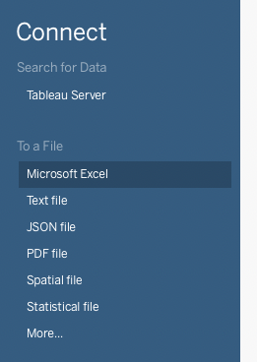
Connect to Your Dataset
From the Tableau menu, click on “Microsoft Excel” and add a single excel file,
where each sheet is a table in your project.
In the opened editor,
Drag the orders sheet to the canvas.
Click on “Sheet1” below to move to the workspace area to create a visualization.

Slide 25
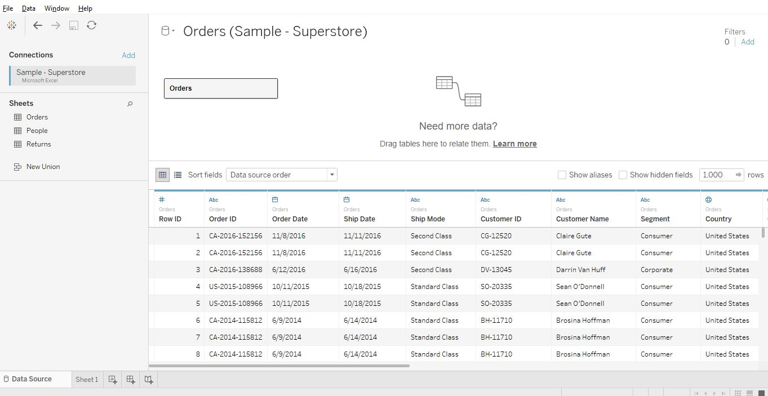
Connect to Your Dataset

Slide 26
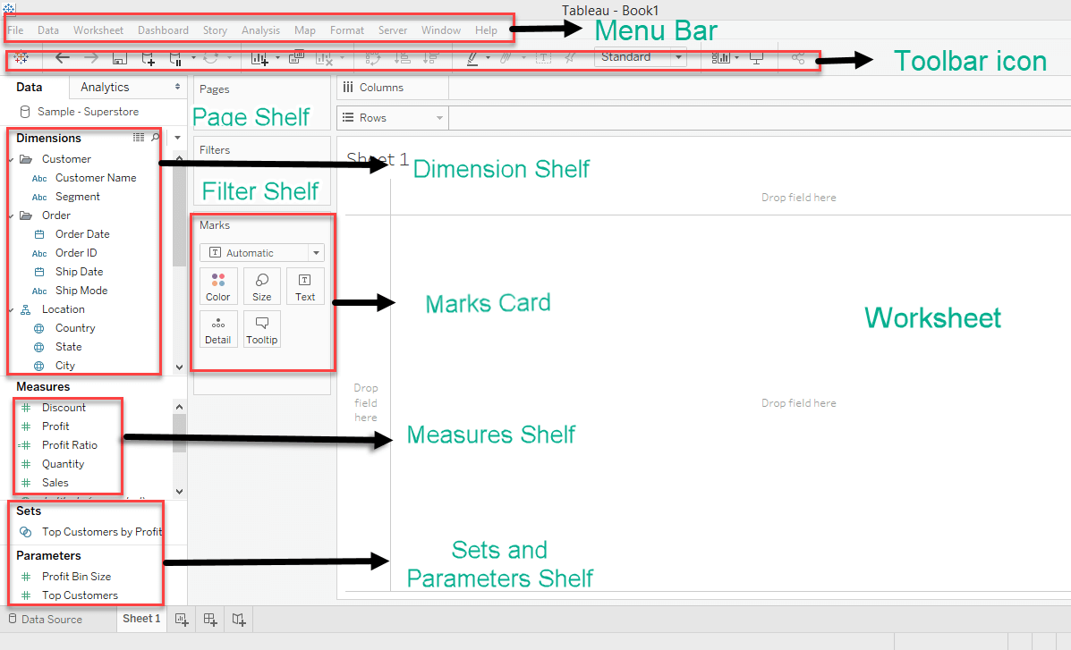
Workspace

Slide 27
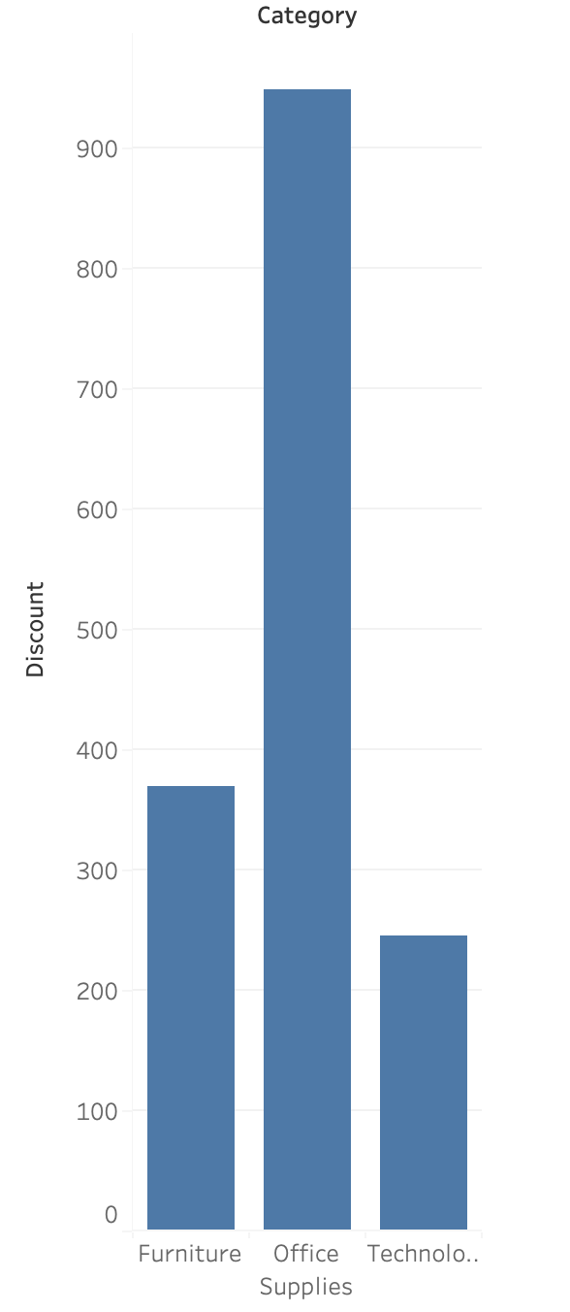
My First Visualization
Query: What is the sum of Discounts of each category?
Drag the Category into Columns and then Discounts into Rows.

Slide 28
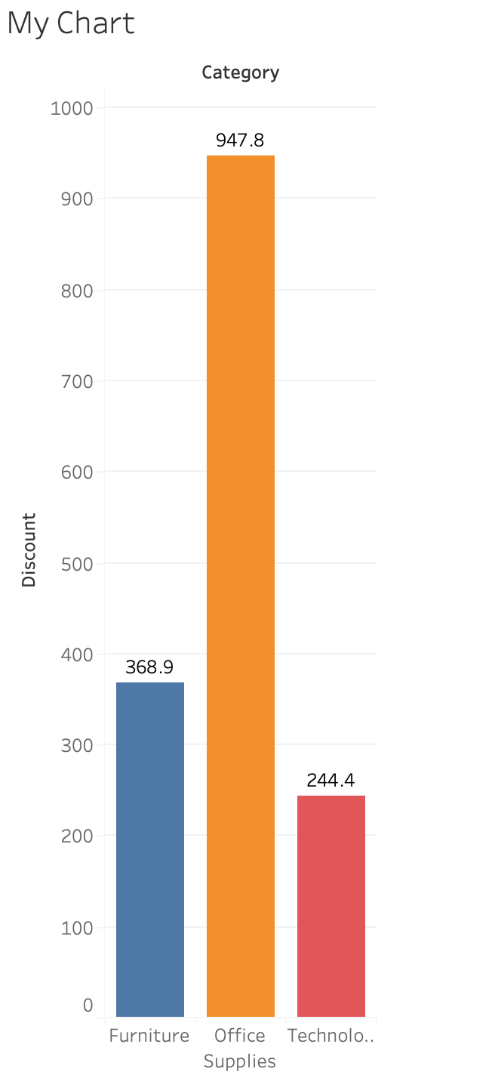
Legends and Colors
To rename simply double click on the title, or sheet1 and a new dialog box appears. Font, Font size, Font color, alignment can be changed.
To apply colors based on category, drag category from the columns to the color in Marks shelf.
To annotate each bar, shift/command + drag SUM(Discount) to the Label in Marks shelf.

Slide 29
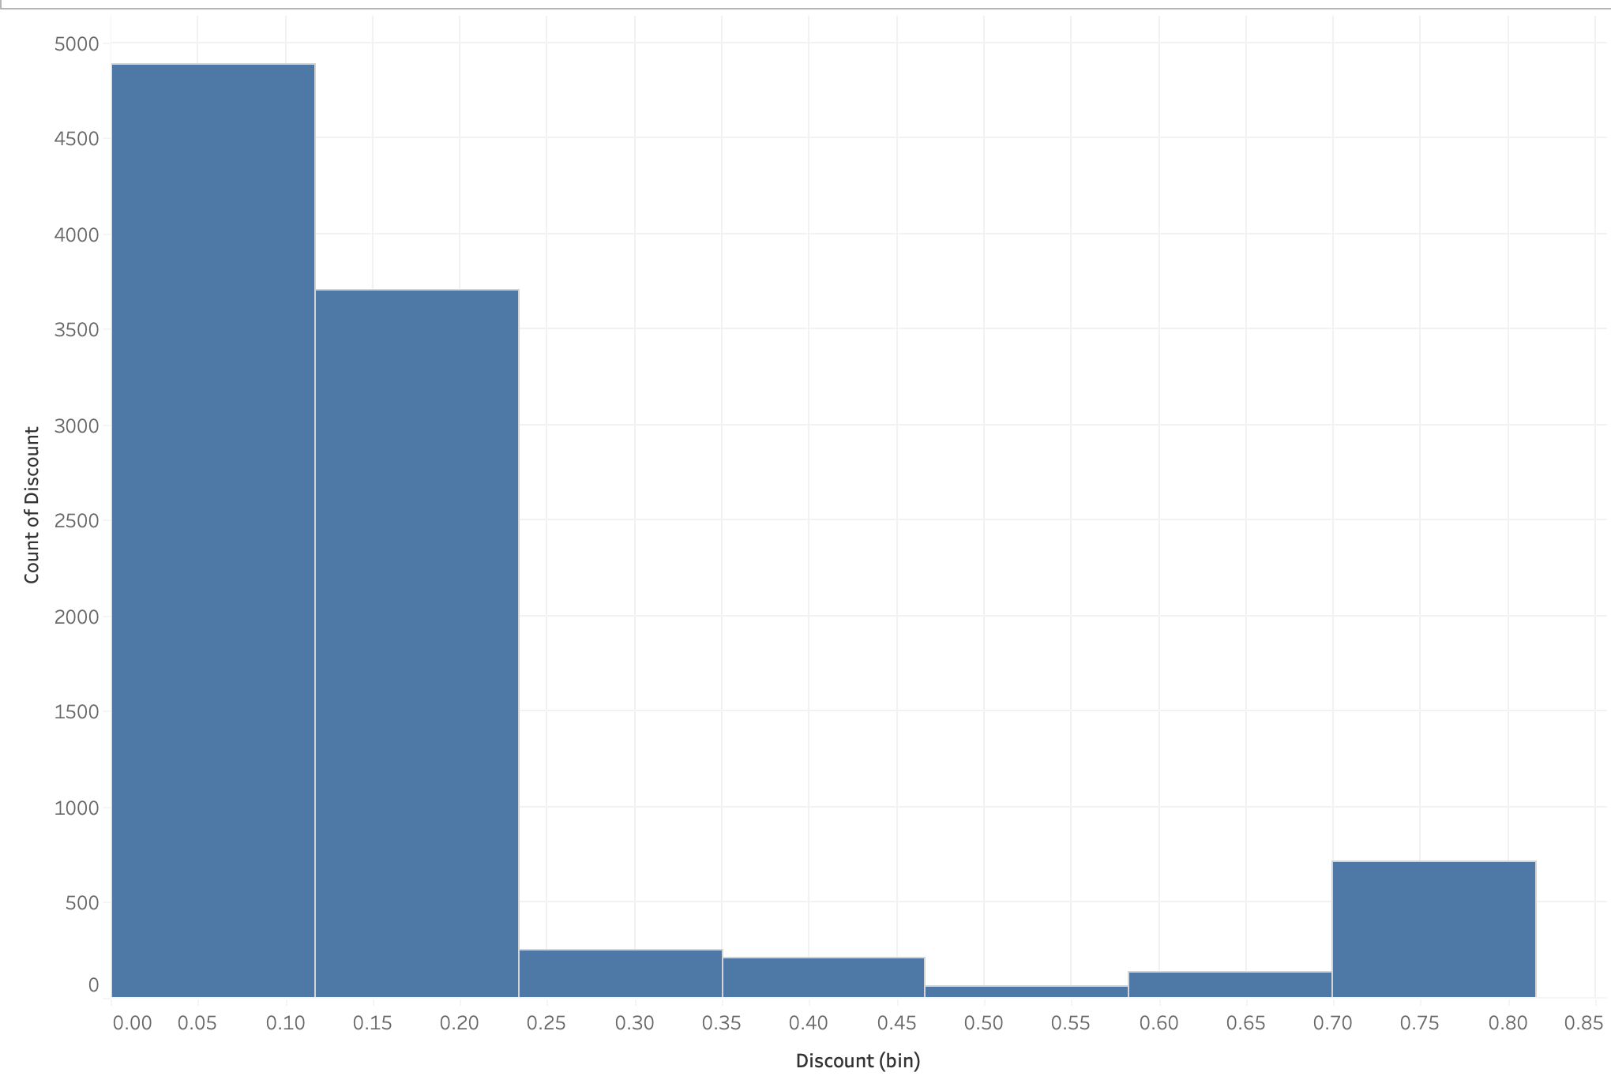
Histogram
Click on SHOW ME in the toolbar, a histogram needs just one measure.
Remove “columns” and “rows”.
Click Discount from the data pane.
Select histogram to create a visualization.

Slide 30
Filters
Select the dimension/measure that needs to be a filter and drop it on the Filter pane. For example – Region and shipping mode.
Right-click on the Region Filter pill and select show filter.
Repeat the same for Shipping Mode.
Add Sales to “rows”.

Slide 31
Table Calculations
A common way to find an aggregate of columns/rows is table calculation. Select Analysis and then select Percentage of to get percentage values or select Total to get total across rows/columns.
Right-click on SUM(Profit) in the marks pane and select Add Table Calculation.
In the dialog box, relevant table calculations can be selected.
For example, % of total needs be added then we can select Percentage of Total and in Compute Using Table (Down)

Slide 32
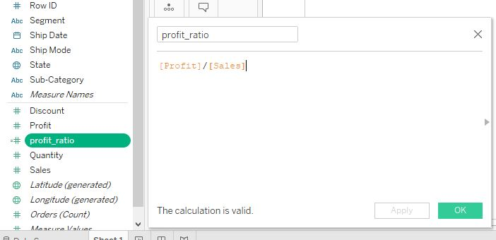
Table Calculations
Calculated Field to create profit percentage:
Select Analysis on the toolbar, then select create calculated field.
We will use the formula [Profit]/[Sales] as profit ratio.
Name the calculated field as profit_ratio and click Apply.
Unlike available columns such as Discount, Profit, profit_ratio has a different symbol.

Slide 33
Parameters
Tableau parameters help users define values, which then can be processed by a calculated field(can also be used in set, reference line etc).
Drag Customer ID to Filter shelf.
Right-click on it, and a dialog box appears. Click on Top then select By Field, then select Create New Parameter.
A new dialog box appears, rename it as Top N. Click OK.
The Top N parameter will be visible on the parameter shelf.
Right-click on it, and select Show Parameter.
Using parameter control, the number of customers shown can be adjusted.

Slide 34
Create Dashboard
Select Dashboard and New Dashboard from the toolbar.
Under the dashboard and sheets pane, the existing charts/sheets appear.
Drag the drop the relevant sheet onto the dashboard.
To add filters to the dashboard – Select Analysis from the toolbar, under it select Filter, all relevant filters appear. Go ahead and choose the one appropriate for the current dashboard.

